Slide 1
The Evolution of Mobile Payment
Alex Frenkel
18.12.2019

Slide 2

What is Mobile Payment
A mobile payment is a money payment made for a product or service through a portable electronic device such as a tablet or cell phone.
Mobile payment technology can also be used to send money to friends or family members.

Slide 3






Mobile Payment Players
2014, the starting year

Slide 4
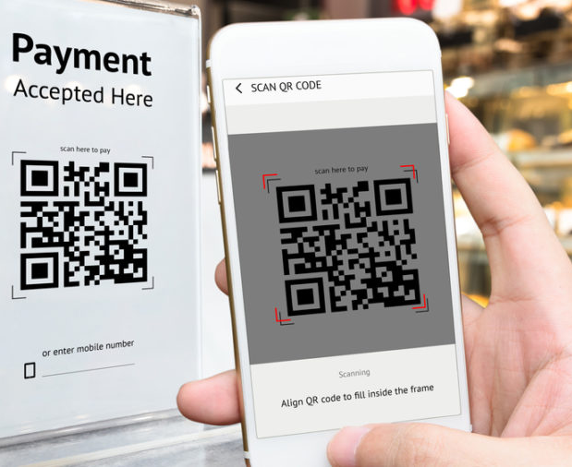
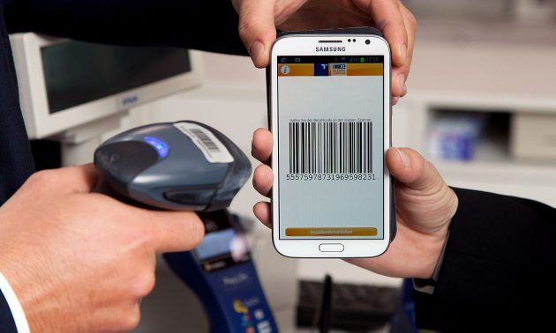
Mobile payments first became popular in Asia and Europe
The QR code payments carry the purchase transaction information to the mobile device of the buyer/customer.

Slide 5
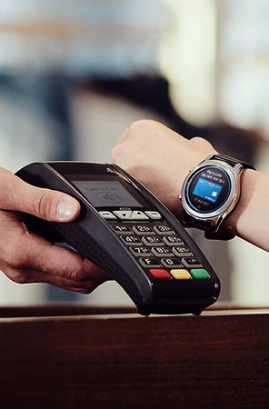
Benefits of Mobile Payment
Elimination of physical wallet
Smart phone
Smart watches (eSIM)
More secure than a credit card
Individual security codes are generated by the mobile service for each transaction
(Hiding your credit card type)
Notes:
The Apple Watch does not have a sim slot. It uses a digital eSim built in to the device that your carrier must activate and set up
Individual security codes are generated by the mobile service for each transaction, this method of payment is significantly safer than using a physical card

Slide 6


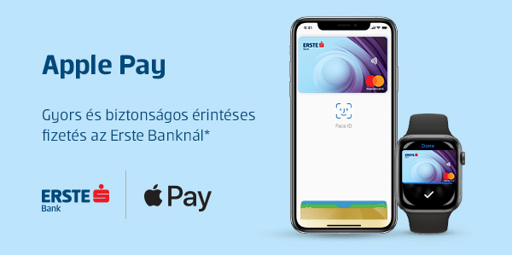


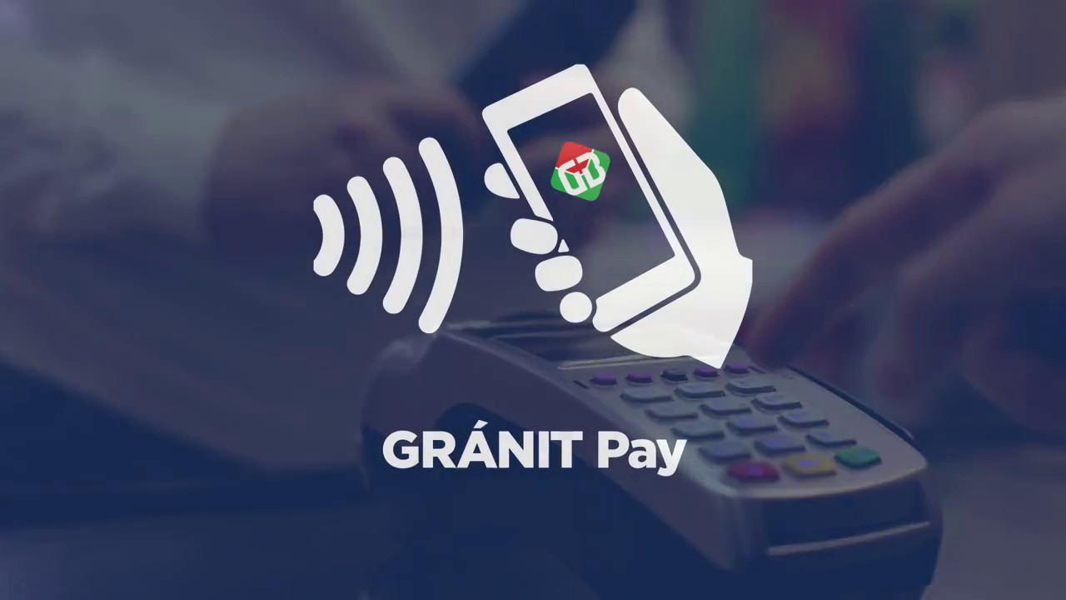
Mobile Payment in Hungary

Slide 7

Thank you

